Slide 1
Purpose of the Presentation
Purpose: Awareness and information about congenital CMV for educators
Intended Audience: Special Education Teachers, Administrators, Related Service Providers, and other educators
Time: Intended to be an overview of congenital CMV (30 min sharing all slides)
Format: Slideshow presentation that an individual can use to share information about congenital CMV with others. This particular presentation is intended for educators; however, information could be relevant to multiple audiences.
This presentation was created March 2025 by the following workgroup: Carla Larson, Gina Liverseed, Jess Moen, Mary Cashman-Bakken, Dr. Megan Pesch, and Tiffany Gumm
Blank space at the top and bottom of the slides is saved for closed captions depending on your needs
Notes:
This slide only for presenter information.
Skip this slide when presenting.

Slide 2
Preparing for this presentation:
Review slides for your own content understanding and ensure you can access the videos/links.
Determine which slides are applicable to share with your audience.
Share congenital CMV handouts/infographics for participants as makes sense for the audience. Some places to look:
MDH Cytomegalovirus and Congenital Cytomegalovirus
MDH The Vivian Act Legislation
National CMV Foundation Educational Downloads
CDC Cytomegalovirus and Congenital Cytomegalovirus Infection
Notes:
This slide only for presenter information.
Skip this slide when presenting.

Slide 3
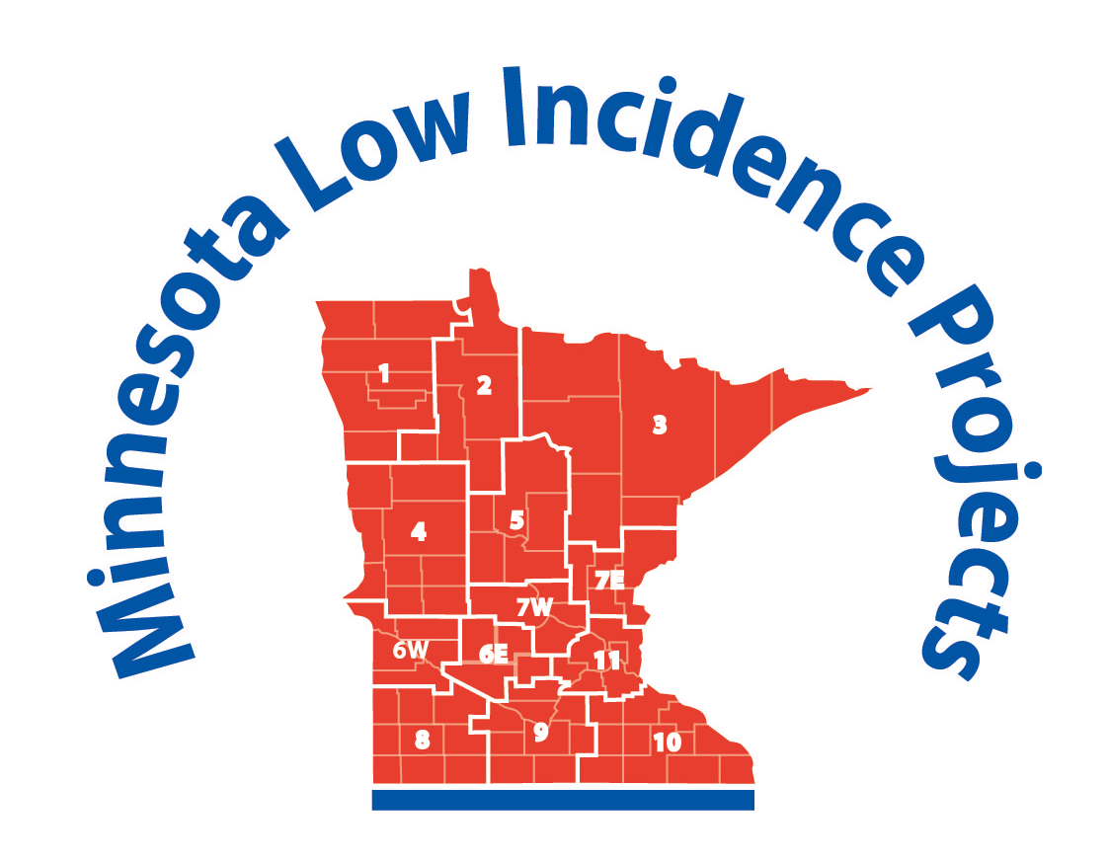

What is congenital CMV and why it is important?

Slide 4

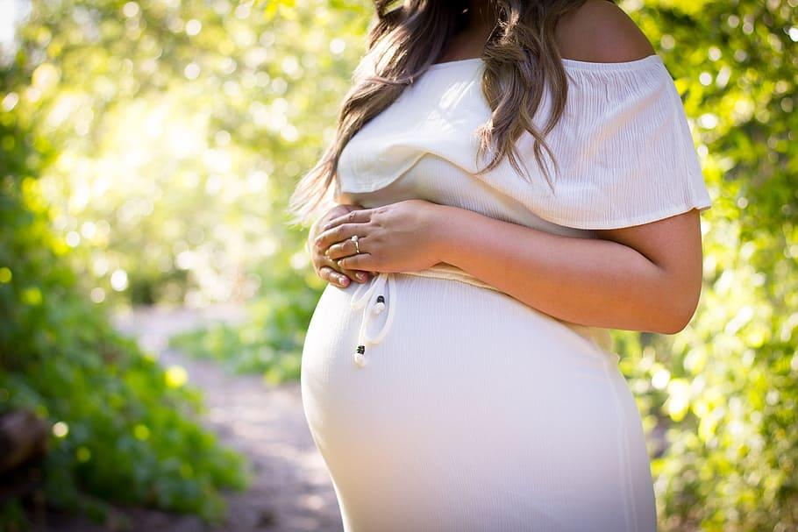
What is Cytomegalovirus?
Cytomegalovirus (CMV)
Congenital Cytomegalovirus (cCMV)
Common and widespread virus
Can cause mild cold like symptoms
Most US adults have been exposed
Generally harmless in healthy people
People who are pregnant and develop an active CMV infection can unknowingly pass the virus to their growing fetus.
When the baby is born with a CMV infection, it is called cCMV.

Slide 5
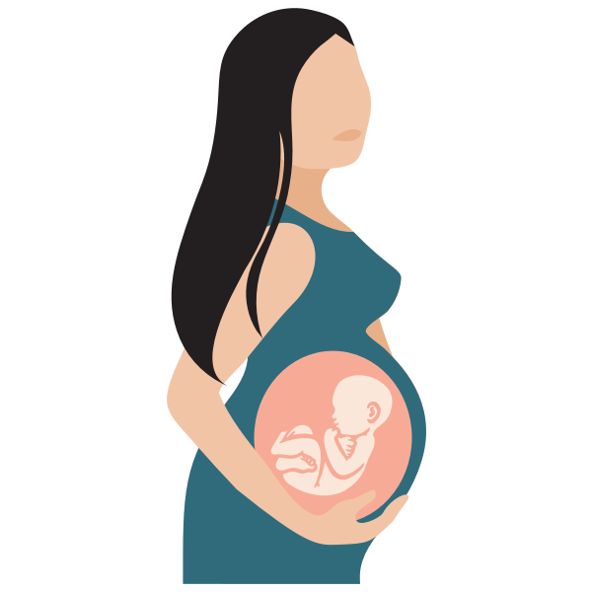




How is Cytomegalovirus Transmitted?
Cytomegalovirus (CMV)
Congenital Cytomegalovirus (cCMV)
CMV is transmitted by direct contact of mucous membranes or open skin with body fluids (such as saliva, urine, nasal mucus, tears, blood, semen, vaginal fluids, stool, breastmilk) from someone with an active CMV infection.
Congenital CMV is when a person who is pregnant develops an active CMV infection and unknowingly passes the virus to their growing fetus.
When the baby is born with a CMV infection, it is called congenital CMV.

Slide 6
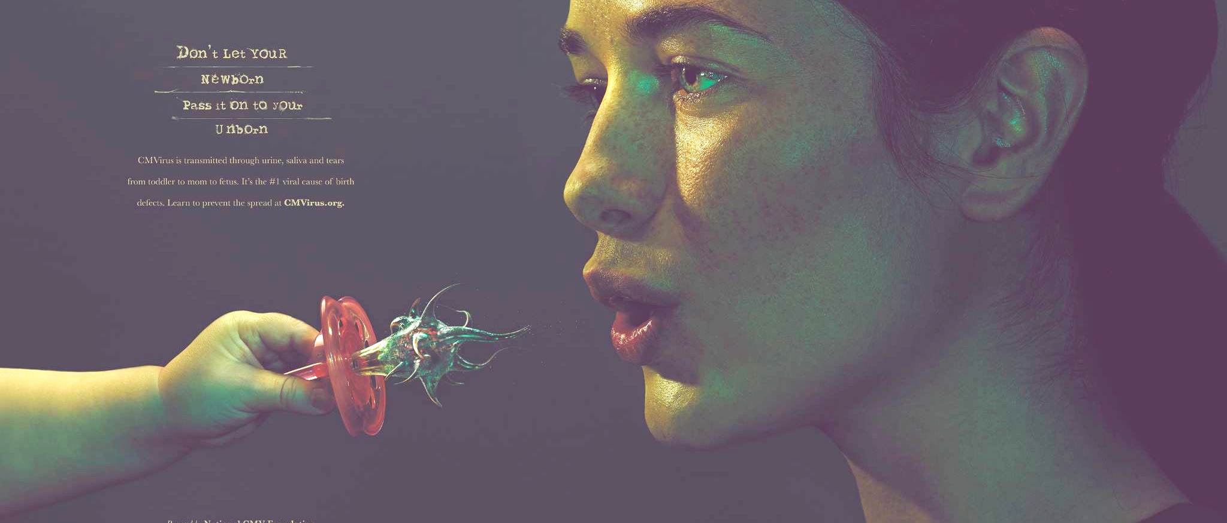
CMV Awareness poster.
Notes:
Image from the National CMV Foundation ad campaign: Educational Downloads: https://www.nationalcmv.org/resources/educational-downloads

Slide 7
Minnesota Congenital CMV Screening
Minnesota is the first state to screen every newborn for congenital CMV! (February 2023)
Purpose
MN Screening
Follow-Up
Identify infection and any health or developmental concerns as early as possible.
Offer interventions that can help minimize the impact of the virus.
Newborn CMV screening through the Minnesota newborn screening panel (blood spot)
If CMV is detected, the baby’s health care provider is notified, and a urine test is collected before the baby is 21 days old to check for the virus.
Initial medical evaluation and treatment
Letter and information booklet from MDH sent to families
MDH connects families with a Local Public Health nurse
Ongoing hearing monitoring
Public health longitudinal surveillance
Notes:
Optional information you can share or look at during a presentation
Minnesota specific legislation and congenital CMV screening:
MDH Cytomegalovirus and Congenital Cytomegalovirus https://www.health.state.mn.us/diseases/cytomegalovirus/index.html
MDH The Vivian Act Legislation https://www.health.state.mn.us/diseases/cytomegalovirus/vivianact.html
Minnesota Legislature Statute 144.064 The Vivian Act https://www.revisor.mn.gov/statutes/cite/144.064
Video (1:54 min): WCCO News Minnesota is first US state to screen all newborns for congenital cytomegalovirus https://www.cbsnews.com/minnesota/news/mdh-minnesota-is-first-us-state-to-screen-all-newborns-for-congenital-cytomegalovirus/

Slide 8
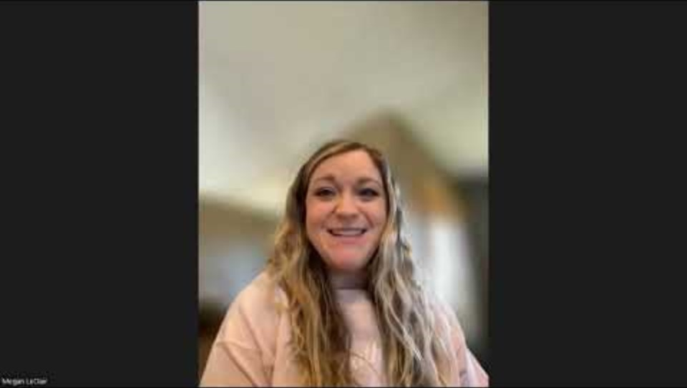
Parent Stories: Diagnosis
Video (0:44 sec): https://youtu.be/cJmeUpaoWuY
Notes:
Video (0:44 sec)
MN parent, Megan, shares about her daughter’s diagnosis of congenital CMV shortly after birth.
https://youtu.be/cJmeUpaoWuY

Slide 9
CMV Prevalence
According to the Centers for Disease Control and Prevention (CDC), congenital CMV is the most common viral cause of birth defects and developmental disabilities in the U.S.
1 in 200 children are born with congenital CMV
Congenital CMV is arguably the most common preventable cause of neonatal disability in the U.S.
More children will have disabilities due to congenital CMV than other well-known infections and syndromes
It is more common for families who have a toddler at home, to have a baby born with congenital CMV.
Notes:
Often times congenital CMV is more common with families who have a toddler at home research references:
Source: Pass RF, Little A, Stagno S, Britt WJ, Alford CA. Young children as a probable source of maternal and congenital cytomegalovirus infection. New England journal of medicine. 1987 May 28;316(22):1366-70. https://www.nejm.org/doi/full/10.1056/NEJM198705283162203
Source: Leruez-Ville M, Magny J-F, Couderc S, et al. Risk factors for congenital cytomegalovirus infection following primary and nonprimary maternal infection: a prospective neonatal screening study using polymerase chain reaction in saliva. Clin Infect Dis. 2017;65(3):398–404 https://academic.oup.com/cid/article/65/3/398/3737620#google_vignette
National CMV What Everyone Needs to Know About Congenital Cytomegalovirus https://www.nationalcmv.org/getattachment/Resources/educational-downloads/downloads/Congenital-CMV-Booklet/Congenital-CMV-Booklet-(1).pdf.aspx?ext=.pdf

Slide 10
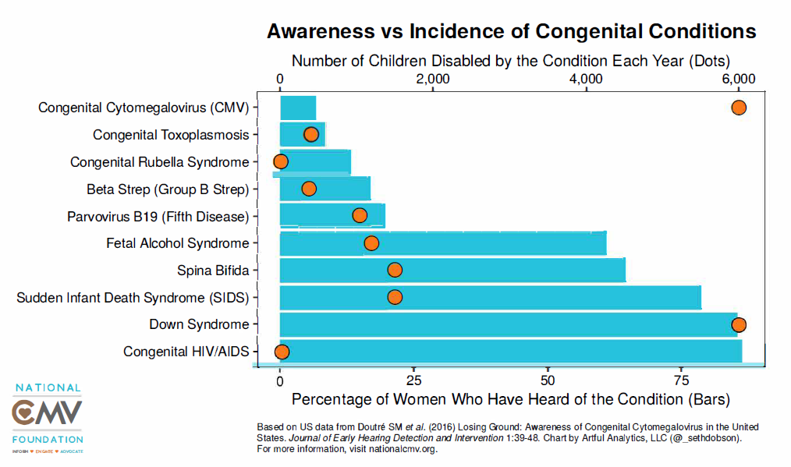
CMV Prevalence chart
Notes:
This graph is based on US data from 2016:
Orange circles indicate the number of children disabled by the condition each year
Blue bars indicate the percentage of women who have heard of the condition
You can see the for congenital CMV (top) the orange circle indicates that there are approximately 6000 children disabled by congenital CMV each year in the US, while the blue bar shows a relatively low percentage of women who have heard of the condition.
In contrast if we look at Down Syndrome (second from the bottom) the orange circle indicates approximately the same number of children are disabled by down syndrome as are congenital CMV. What is drastically different is the percentage of women who have heard about down syndrome (blue bar) as compared to congenital CMV.
Infographic from National CMV Foundation Educational Downloads: https://www.nationalcmv.org/getattachment/Resources/educational-downloads/downloads/Awareness-vs-Incidence/Awareness-v-Incidence-Dobson.pdf.aspx?ext=.pdf

Slide 11
Congenital CMV Possible Impacts
Born Symptomatic |  |  |  |  | Born Asymptomatic
Death Miscarriage Stillbirth Infant or Child Loss | Medically Fragile Cerebral palsy Seizures Failure to Thrive Hearing Loss Vision Loss | Multiple Impairments Cerebral palsy Vision Loss Hearing Loss | Developmental Delays Cognitive delays Learning issues Feeding and sleeping issues Vision Loss Hearing Loss | Hearing Loss Hearing Aids Cochlear Implants Communication and Learning Issues Mild vision disorders | None No visible delays or impairments
 | Severe |  | Moderate |  | Mild
Adapted from the National CMV Foundation. Note: This table is not meant to be all-inclusive, each patient and case is distinctive
Notes:
Approximately 90% of all infants who are infected with CMV before delivery are born without systems of the virus = asymptomatic
However, the remaining 10% will have varying degrees of abnormalities = symptomatic
Notice that hearing loss is considered to be asymptomatic.

Slide 12
Monitoring Importance
Long-term Outcomes in Asymptomatic congenital CMV:
~20%
Hearing Loss by 18 years
~45%
Vestibular & Gaze Stability Dysfunctions
~30%
Balance Difficulties
?
Autism Risk
?
Learning Disabilities
?
Developmental Delays

Slide 13
Inclusion
Children with a congenital CMV infection should not be excluded from school or other settings.
Children born with congenital CMV pose no threat to their peers and no more of a threat to those at risk for CMV infection (ie. pregnant women) than would any other child.
Notes:
Most children born with congenital CMV (cytomegalovirus) will shed, or release, the virus in their body fluids throughout their toddler and preschool years. However, CMV is a very common childhood virus, affecting 70 percent of healthy children between 1 and 3 years of age.
Daycares, preschools, schools, therapy centers, churches, and community members should not require a child to be tested for CMV shedding. According to the Centers for Disease Control and Prevention (CDC), screening of children for CMV infection is not recommended, and infected children should not be excluded from school or other settings. Children born with congenital CMV pose no threat to their peers and no more of a threat to those at risk for CMV infection (ie. pregnant women) than would any other child.
Slide is an excerpt from the National CMV Foundation flyer on CMV Shedding https://www.nationalcmv.org/getattachment/Resources/educational-downloads/downloads/CMV-Shedding/CMV-Shedding-Flyer.pdf.aspx?ext=.pdf

Slide 14
Inclusion Q&A
Question: I am pregnant (or attempting to become pregnant) and one of the young children in my program was diagnosed with congenital CMV. Should I avoid being around this child to protect myself from a CMV infection?
Answer (from MN Department of Health): No, you do not need to avoid being around a child with congenital CMV. Asymptomatic excretion of CMV is common in people of all ages; a child with a congenital CMV infection should not be treated differently from other children. It’s important to protect yourself from a CMV infection by using standard precautions with ALL children.
AAP Red Book: Report of the Committee on Infectious Diseases (2024)
Notes:
Most children born with congenital CMV (cytomegalovirus) will shed, or release, the virus in their body fluids throughout their toddler and preschool years. However, CMV is a very common childhood virus, affecting 70 percent of healthy children between 1 and 3 years of age.
Daycares, preschools, schools, therapy centers, churches, and community members should not require a child to be tested for CMV shedding. According to the Centers for Disease Control and Prevention (CDC), screening of children for CMV infection is not recommended, and infected children should not be excluded from school or other settings. Children born with congenital CMV pose no threat to their peers and no more of a threat to those at risk for CMV infection (ie. pregnant women) than would any other child.

Slide 15
Tips to reduce your risk of getting CMV
Wash your hands with soap and water often, especially after wiping a child’s nose or mouth and changing diapers.
Try to avoid contact with saliva by kissing a child on the forehead instead of the lips.
Try to avoid sharing food, drinks, straws or eating utensils with young children. Wash your hands after handling these items.
Avoid putting things in your mouth that have been a child’s mouth, such as a pacifier or toothbrush.
Properly clean/disinfect objects and surfaces that may have a child’s urine or saliva on them.
Notes:
National CMV Educational Downloads Prevention Infographic https://www.nationalcmv.org/getattachment/8e6320fa-d579-4677-918e-03f3a801d369/June-Prevention-Infographic-(1).pdf.aspx?ext=.pdf

Slide 16
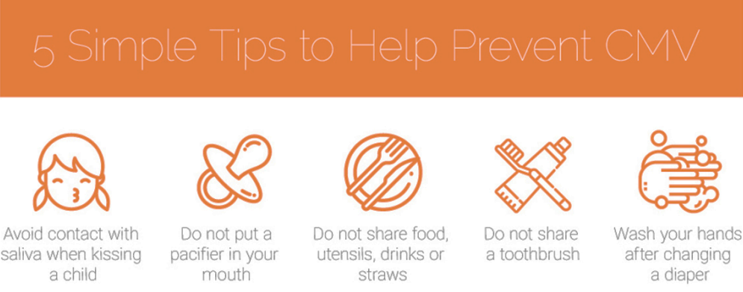
CMV Prevention Infographic
Notes:
National CMV Educational Downloads Prevention Infographic https://www.nationalcmv.org/getattachment/8e6320fa-d579-4677-918e-03f3a801d369/June-Prevention-Infographic-(1).pdf.aspx?ext=.pdf

Slide 17
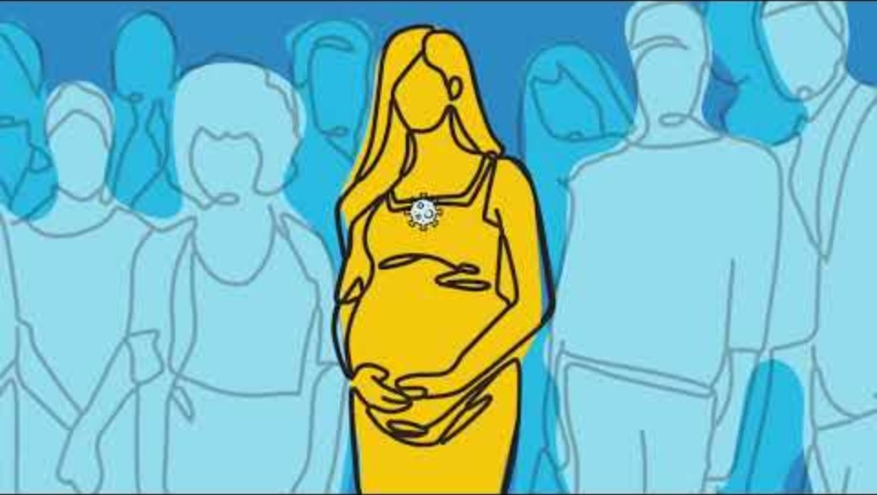
Video: Preventing Congenital CMV
Video (4:16 mins, sec): https://youtu.be/1XgQcnYwisU?feature=shared
Notes:
Video 4:16 min - https://youtu.be/1XgQcnYwisU?feature=shared
Video was created by the National CMV Foundation and the Colorado Chapter of the American Academy of Pediatrics.

Slide 18
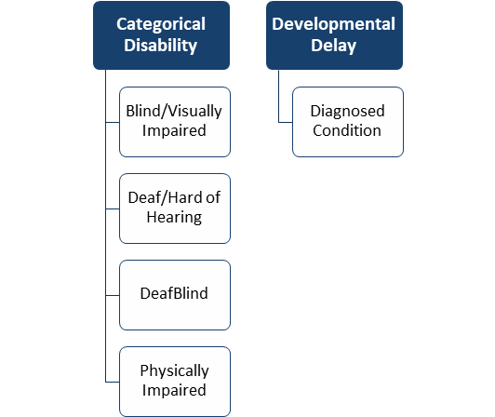
Eligibility for MN Special Education Services
Potential Eligibility under Part C IDEA ​with Congenital CMV Diagnosis. ​
Cytomegalovirus is a known condition to hinder development listed on the Early Intervention Colorado List. (Established Conditions Database)
A congenital CMV diagnosis should have continued monitoring for progressive sensory loss.
Notes:
Early Intervention Colorado Established Conditions List https://docs.google.com/spreadsheets/d/1AkysbUYoJSXn0US_DHw-ZIkn22xU0d8l_99fEBy7NV8/edit?gid=1292800278#gid=1292800278
Cytomegalovirus is listed, not congenital cytomegalovirus.
According to the MN Department of Education (MDE) statement given in October 2023:
congenital CMV has always been included on this list (Colorado Established Condition Database)
The diagnosis of cytomegalovirus is the determining factor, not timing of acquirement
Unless otherwise specified, the timing of the diagnosis of any established condition does not affect its ability to be used toward eligibility.
It is important to ask families if their child has a diagnosis of cCMV.

Slide 19
Continued Monitoring: Hearing
Hearing loss related to CMV can be fluctuating and/or progressive, so it is important that all children have continued and close monitoring with an audiologist to detect changes.
MDH Early Hearing Detection and Intervention Audiology Guidelines for Infants with Congenital Cytomegalovirus
Notes:
How might the child’s clinical audiologist and school educational audiologist collaborate to ensure ongoing monitoring is occurring and relevant information is shared?
MDH EHDI Audiology Guidelines for Infants with Congenital Cytomegalovirus https://www.health.state.mn.us/docs/people/childrenyouth/improveehdi/audiogdlnccmv.pdf

Slide 20
Continued Monitoring: Vestibular
It is recommended that all children with congenital CMV have vestibular screening because they are at an increased risk for vestibular dysfunction that can disrupt their balance and visual gaze. It is recommended that audiologists include screening for vestibular dysfunction at each follow up visit.
MDH Early Hearing Detection and Intervention Audiology Guidelines for Infants with Congenital Cytomegalovirus
cCMV Public Health and Policy Conference Series: Pediatric Vestibular Dysfunction

Slide 21
Continued Monitoring: Overall Development
The child’s overall growth and development should be monitored closely.
Recent research has shown that children with congenital CMV are more likely to be diagnosed with autism spectrum disorder (ASD) than their peers. It is recommended that parents and professionals be proactive in monitoring for early signs and doing formal assessments for ASD at appropriate ages. Families of children with congenital CMV may seek specialized assessments or care from a Developmental Behavioral Pediatrician.

Slide 22
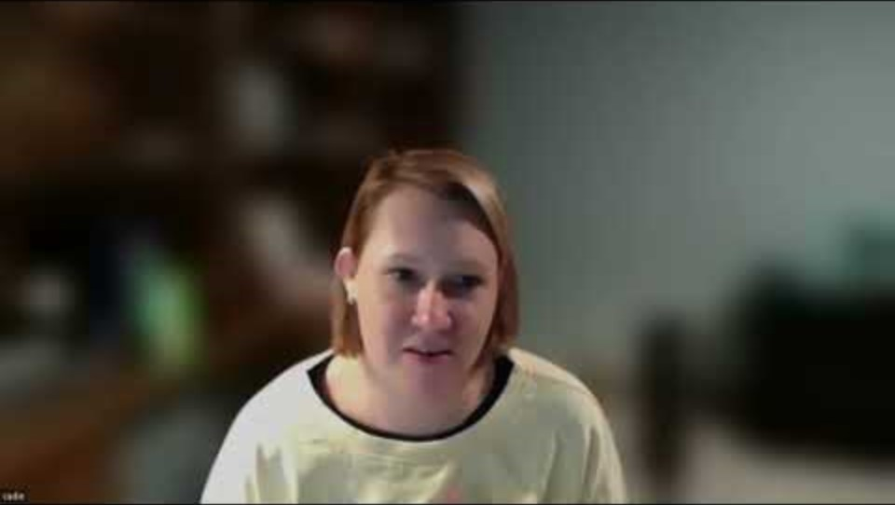
Parent Stories: Reality and Awareness
Video (0:39 sec):
https://youtu.be/WQvaPrB_ff8
Notes:
Video (0:39 min)
MN parent, Cadie, shares her reality in the first few months after her daughter received a diagnosis of congenital CMV and the multitude of various appointments they experienced.
https://youtu.be/WQvaPrB_ff8

Slide 23
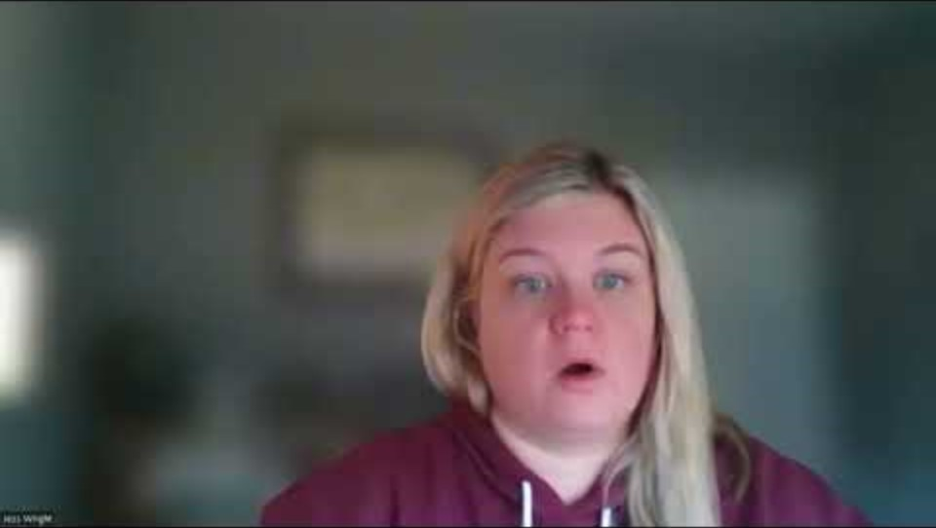
Parent Stories: Early Intervention
Video (1:06 min, sec):
https://youtu.be/gkBgi1Tp-JU
Notes:
Video (1:06 min)
MN Parent, Jess, shares about the benefits her family received from early intervention with a child who has congenital CMV and was asymptomatic at birth.
https://youtu.be/gkBgi1Tp-JU

Slide 24
IFSP or IEP Considerations: Document
It is important to document the congenital CMV diagnosis in every IFSP or IEP and update with symptoms:
This ensures the child’s diagnosis is not ‘lost’ from report to report and/or case manager to case manager.
Provides necessary information for the child’s team to ensure proper development monitoring, health care follow-up and supports.

Slide 25
IFSP or IEP Considerations: Impact Statement
Importance for all service providers to be aware of congenital CMV possible impacts:
Awareness of how cCMV might affect a child
Awareness of how cCMV might manifest over time
Awareness of how a cCMV diagnosis could be impacting the child’s caregivers
Importance of quality monitoring of all areas of development to quickly address any areas of need if they arise.
Practitioners share relevant information in a timely manner with caregivers and connect to resources and other families

Slide 26
IFSP or IEP Considerations: Impact Statement Example
[Name] was born with congenital cytomegalovirus (cCMV), which is a viral infection [he/she] caught in utero. Children with congenital CMV are at higher risk of developmental delays and differences due to the virus impacting their in-utero development. Some of the effects of congenital CMV on a child’s development can be apparent early in infancy, whereas other impacts may appear later on in childhood. In [name] case, they have the following apparent impacts of congenital CMV: [list known impacts]. Children with congenital CMV are also at greater risk of developing new onset or progressive hearing loss, autism spectrum disorder, and learning difficulties that may not be apparent early in life. Of note, children with congenital CMV have lower rates of ‘success’ with using Listening and Spoken Language strategies only, therefore multimodal language learning strategies are paramount.
Notes:
Of note regarding comment of lower rates of success using LSL strategies only:
Any paper examining cochlear implant outcomes in children with and without congenital CMV will show that children with congenital CMV have ‘poorer’ outcomes in terms of the typical measures of CI success (listening and spoken language).
Children with congenital CMV still can benefit from from CI’s, but because as a whole they are less likely to achieve fluent use of LSL, it is even more imperative to expose to ASL early.
Children with congenital CMV are also more likely to be autistic, which can make CI use and communication in general more challenging.
Source: Kraaijenga, V. J. C., et al. "Cochlear implant performance in children deafened by congenital cytomegalovirus—A systematic review." Clinical Otolaryngology 43.5 (2018): 1283-1295. https://onlinelibrary.wiley.com/doi/10.1111/coa.13142
Source: Yoshida H, Takahashi H, Kanda Y, Kitaoka K, Hara M. Long-term outcomes of cochlear implantation in children with congenital cytomegalovirus infection. Otology & Neurotology. 2017 Aug 1;38(7):e190-4.

Slide 27
IFSP or IEP Considerations: Impact Statement possible known impacts
Hearing loss
Vision loss
Seizures
Cerebral Palsy
Low Tone
Delayed Gross Motor milestones
Speech/Language/Communication delay
Behavioral difficulties
Global Developmental Delay
Other

Slide 28
IFSP or IEP Considerations: Impact Statement Additions (based on areas of need)
Examples:
[Name’s] speech and language delays impact their ability to communicate and express themselves effectively.
[Name’s] hearing difference impacts their ability to understand and follow verbal instructions in the classroom.
[Name’s] hearing difference impacts their ability to naturally acquire language through implicit learning of what is happening around them.
[Name’s] vision loss impacts their ability to navigate within spaces.

Slide 29
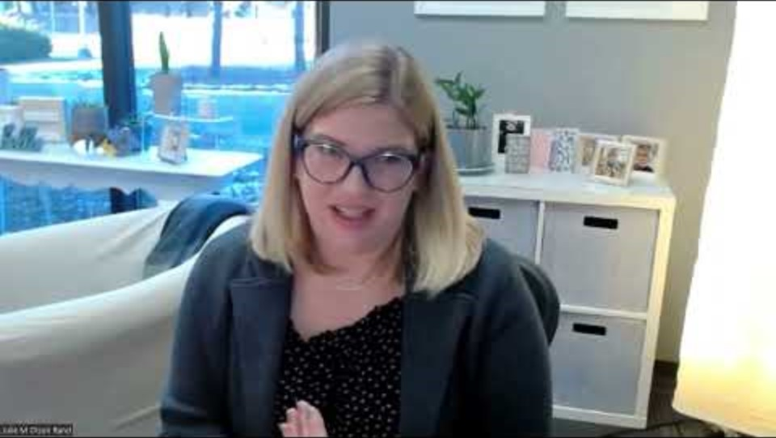
Parent Stories: Language Access
Video (0:39 sec):
https://youtu.be/-ZxDq2W03jY
Notes:
Video (0:39 sec)
MN Parent, Julie, shares about the importance of language access and caution about language deprivation.
https://youtu.be/-ZxDq2W03jY

Slide 30
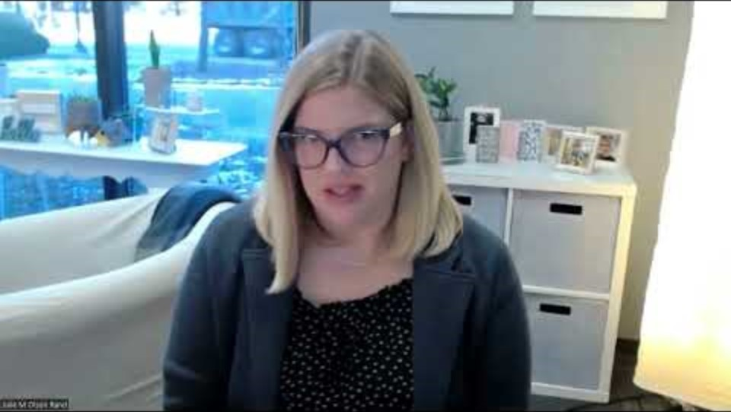
Parent Stories: Words Matter
Video (1:21 min, sec):
https://youtu.be/rRs-4csLCy0
Notes:
Video (1:21 min)
MN Parent Julie, shares about the lasting words and perspective that their daughter’s ENT had on their experience.
https://youtu.be/rRs-4csLCy0

Slide 31
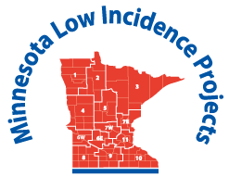
Thank you for Learning more about congenital CMV
The MN Low Incidence Projects and this initiative are made possible with a grant from the MN Department of Education, federal award Special Education-Programs to States, CDFA 84.027A. Unless otherwise specified, this activity is not reflective of official policies or recommendations of the MN Low Incidence Projects, Brightworks, the MN Department of Education, or local education agencies.

Slide 32
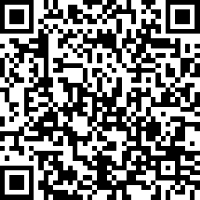
Survey
After learning from this overview presentation on congenital CMV, please complete the following survey, so we can track the presentation’s use for our federal grant goals.
LINK:
https://www.surveymonkey.com/r/cCMV101Packet

Slide 33
Resources: Parent Stories All Videos:
Megan
Cadie
cCMV Screening
Initial Referral Process
Unknown Frustrating and Scary
Early Intervention and Daycare
Exhaustion
Teacher DHH Answers Questions
Outpouring of Support
Having a Point Person
Telling In-Laws

Slide 34
Resources: Parent Stories All Videos, cont.:
Jess
Julie
Early Intervention and Asymptomatic Child
Connect with Other Moms
Importance of Educating Expectant Mothers
Uncertainty of Prognosis
Words Matter ENT
Many Doctor Appts
Dr Visits/Hospital Stays in First Year
Language Deprivation
Deaf Community Access
Additional Thoughts

Slide 35
Resources: Congenital Cytomegalovirus
National CMV Foundation
National CMV Foundational Educational Downloads (referenced in slideshow)
What Everyone Needs to Know About Congenital Cytomegalovirus Booklet
Awareness vs Incidence of Congenital Conditions
CMV Shedding
CMV Prevention Infographic
MN Department of Health Cytomegalovirus and Congenital Cytomegalovirus
Preventing Congenital CMV YouTube Video

Slide 36
Resources: Minnesota cCMV Screening
MN Department of Health The Vivian Act Legislation
Minnesota Legislature Statute 144.064 The Vivian Act
WCCO News Minnesota First US State to Screen All Newborns for Congenital Cytomegalovirus MN
Department of Health EHDI Audiology Guidelines for Infants with Congenital Cytomegalovirus

Slide 37
Resources: Minnesota Early Intervention
MN Department of Education Part C and Part B Resources
MN Help Me Grow
Early Intervention Colorado List of Established Conditions Database

Slide 38
Resources: cCMV Research Articles
Topic: Mother’s at risk for cCMV
Source: Pass RF, Little A, Stagno S, Britt WJ, Alford CA. Young children as a probable source of maternal and congenital cytomegalovirus infection. New England journal of medicine. 1987 May 28;316(22):1366-70.
Source: Leruez-Ville M, Magny J-F, Couderc S, et al. Risk factors for congenital cytomegalovirus infection following primary and nonprimary maternal infection: a prospective neonatal screening study using polymerase chain reaction in saliva. Clin Infect Dis. 2017;65(3):398–404

Slide 39
Resources: cCMV Research Articles, cont.
Topic: Listening and Spoken Language (LSL) for Children with Congenital Cytomegalovirus
Source: Kraaijenga, V. J. C., et al. "Cochlear implant performance in children deafened by congenital cytomegalovirus—A systematic review." Clinical Otolaryngology 43.5 (2018): 1283-1295.
Source: Yoshida H, Takahashi H, Kanda Y, Kitaoka K, Hara M. Long-term outcomes of cochlear implantation in children with congenital cytomegalovirus infection. Otology & Neurotology. 2017 Aug 1;38(7):e190-4.

Slide 40
Minnesota Low Incidence Projects: Grant Statement
The contents of this presentation do not necessarily represent the policy of the federal Department of Education or the state Department of Education, and you should not assume endorsement by the federal or state government. Funding for this event is made possible with a grant from the MN Department of Education. The source of the funds is federal award Special Education – Grants to States, CFDA 84.027A..

